Slide 1

(neo4j)-[:LOVES]->(community)
Siddhant Agarwal (@sidagarwal04) Developer Relations APAC @ Neo4j

Slide 2
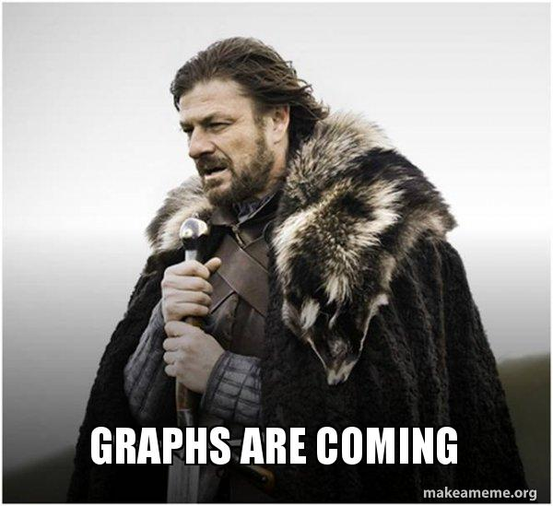
Neo4j: The {Company;Product}
Idea conceived on a flight to Mumbai
Product & Company started in 2007 🇸🇪
Open-Core Model
Free Open-Source Community Edition
Closed-Source Enterprise Edition
Free for local use with Neo4j Desktop / Docker
Current Version: 5.0 (Released in Nov 2022)
Life sciences
Telecommunications
Notes:
Conceived on a flight to Mumbai; First code at IITM; Swedish company at heart, based out of Silicon Valley.

Slide 3
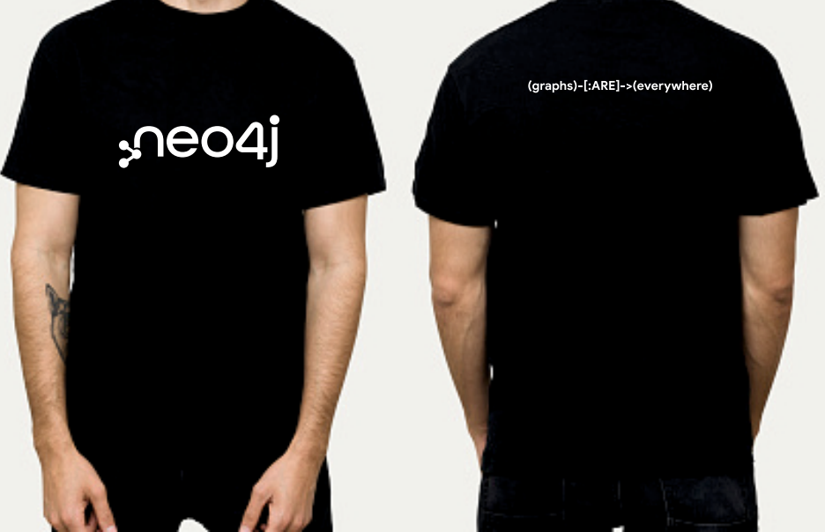
Want to win this awesome Neo4j t-shirt? 😍

Slide 4
Make a twitter post about how excited are you for this session.
Tag @sidagarwal04 & @neo4j
Use Hashtag #GraphsAreEverywhere

Slide 5
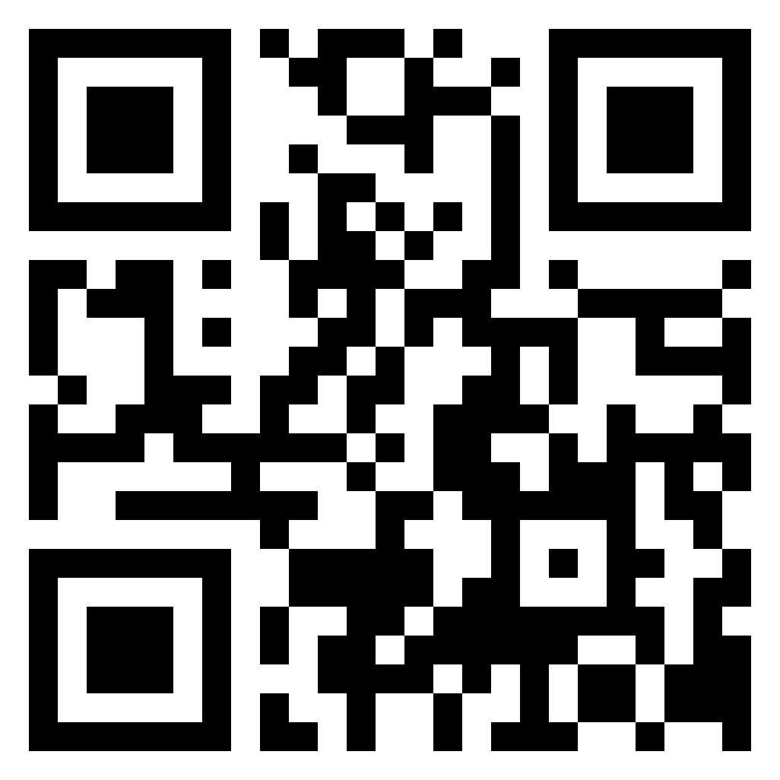
Continue your graph journey with Graph Academy
What is Graph Academy?
Free, Self-Paced, Hands-on Online Training to help you learn how to build, optimize and launch your Neo4j project, all from the Neo4j experts.
What’s more?
2 free certifications designed to test you on your overall knowledge of Neo4j:
Neo4j Graph Data Science Certification
Neo4j Certified Professional
Interested? For more information visit:
www.graphacademy.neo4j.com

Slide 6

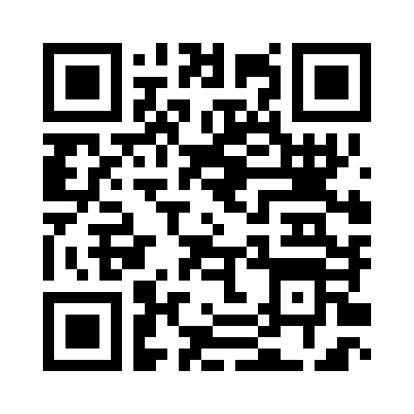
dev.neo4j.com/nodes23

Slide 7
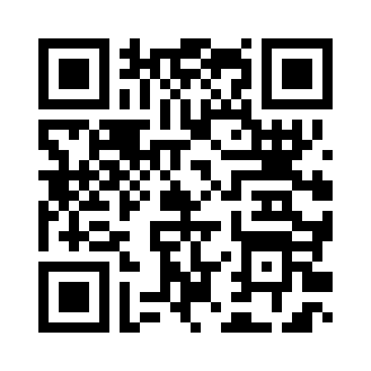
Join Graph Database User Groups Connect with passionate graphistas
What are User Groups?
Developers interested in learning about and working with graph databases for social, spatial, hierarchical or other highly connected data sets. We host hands-on lab sessions, technology reviews and topical lectures. Curious about graphs? Join us!
What’s more?
Apply knowledge and connections to build great products and advance your skills, career, and network. Help your community learn too.
Interested? For more information visit: https://www.meetup.com/pro/neo4j/

Slide 8
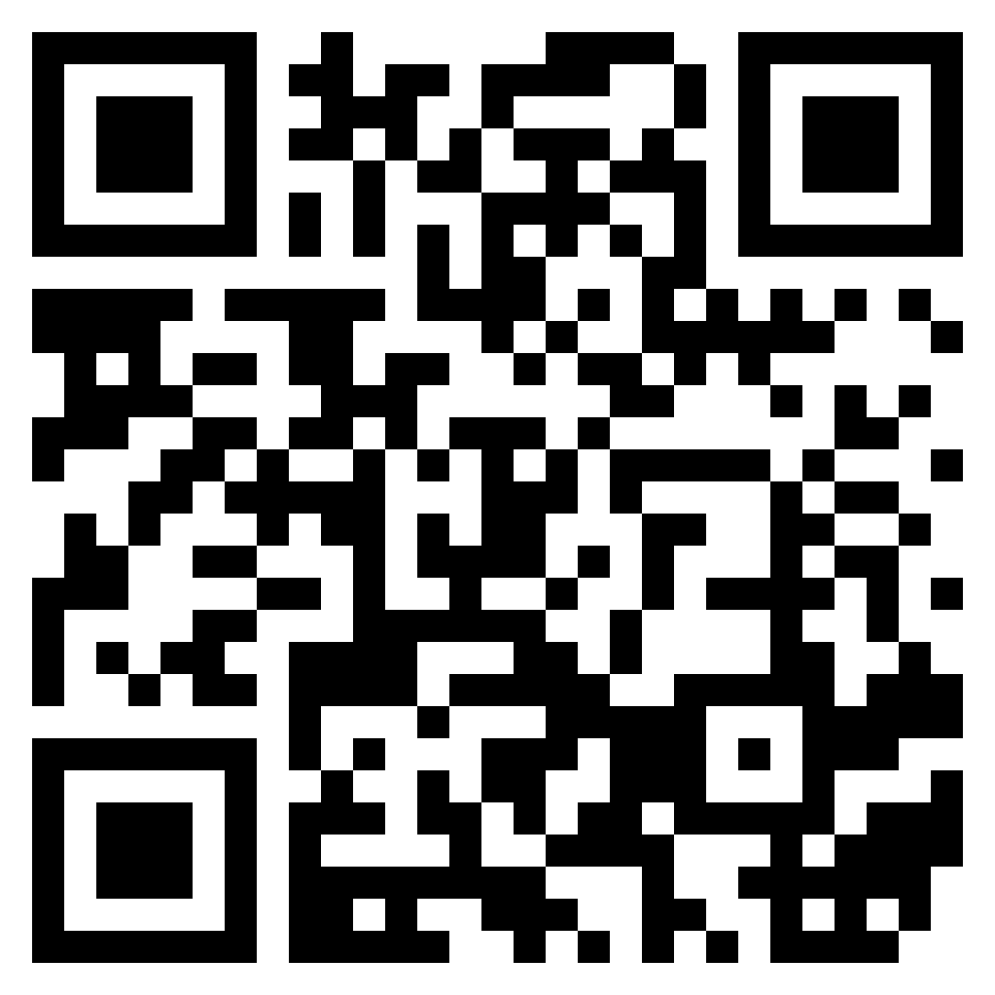
Join Graph Database Pune User Group Connect with passionate graphistas
What are User Groups?
Developers interested in learning about and working with graph databases for social, spatial, hierarchical or other highly connected data sets. We host hands-on lab sessions, technology reviews and topical lectures. Curious about graphs? Join us!
What’s more?
Apply knowledge and connections to build great products and advance your skills, career, and network. Help your community learn too.
Interested? For more information visit: https://www.meetup.com/graph-database-pune/

Slide 9
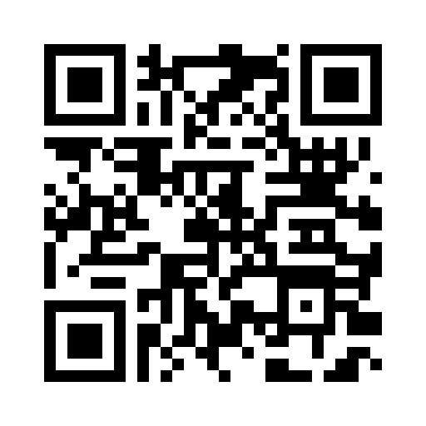
Want to speak at our meetups? Submit your talk
dev.neo4j.com/submit-your-talk

Slide 10

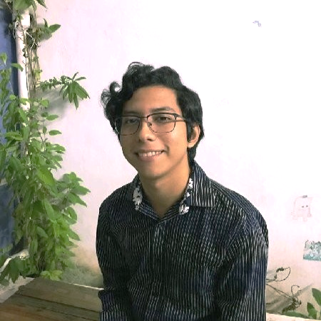


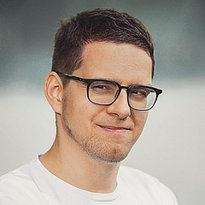



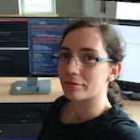





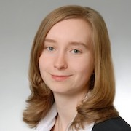


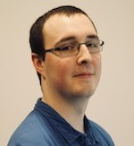



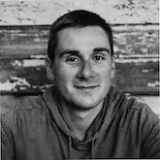






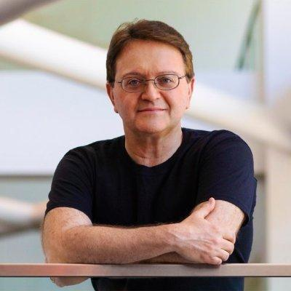
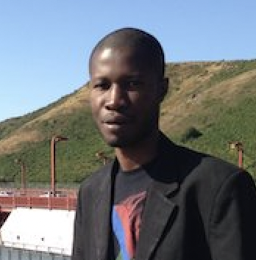

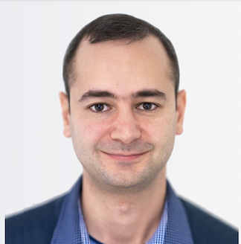
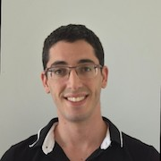




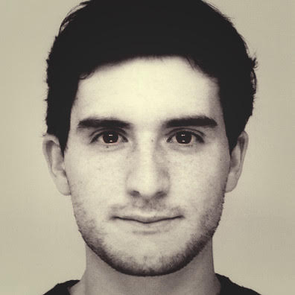


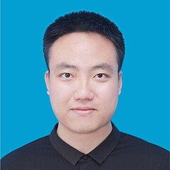


Meet the Neo4j Ninjas Masters of Graphs
Ninjas are:
Active graph bloggers, presenters, GitHub contributors, professors, user group leaders, and researchers
Benefits:
Ninjas benefit from exclusive access to Neo4j experts, VIP event experience, special giveaways and much more
Interested? For more information visit:
https://bit.ly/Neo4jNinjas

Slide 11
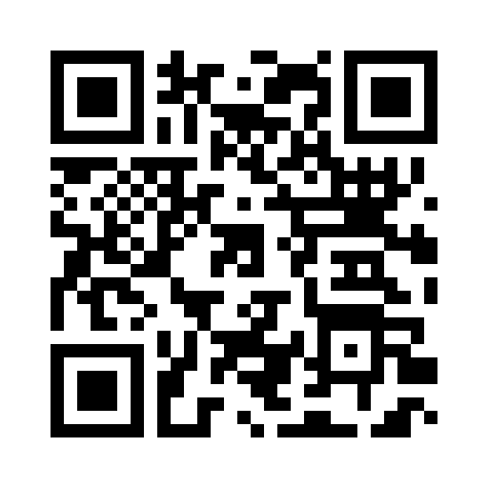
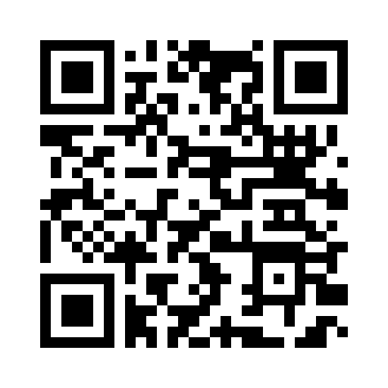
Let’s stay connected with the community
dev.neo4j.com/chat
dev.neo4j.com/community

Slide 12
Meet the Neo4j Ninjas Masters of Graphs
Ninjas are:
Active graph bloggers, presenters, GitHub contributors, professors, user group leaders, and researchers
Benefits:
Ninjas benefit from exclusive access to Neo4j experts, VIP event experience, special giveaways and much more
Interested? For more information visit:
https://bit.ly/Neo4jNinjas

Slide 13
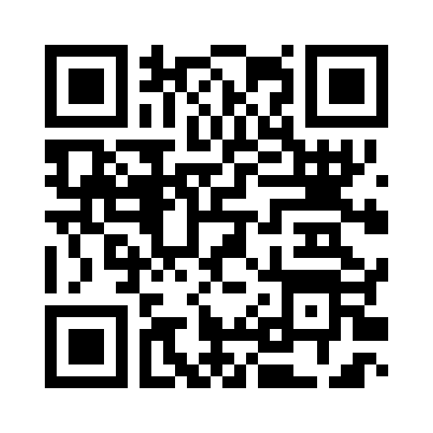
Your Feedback is valuable
dev.neo4j.com/feedback-syd-22mar

